Slide 1



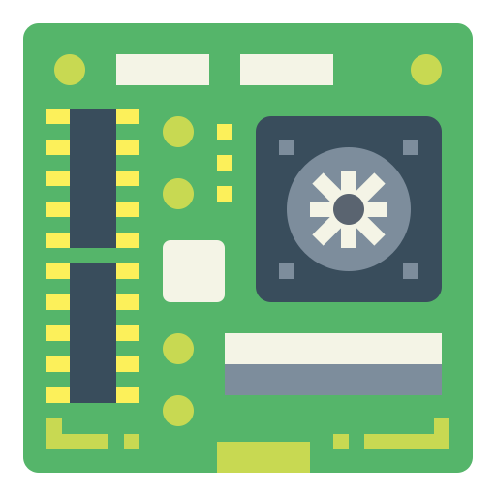










Sensing
Coordination
Storage
Storage
Computation
Computation
Communication
Front End
Edge
Back End
Cloud
Analysis
Internet
Interfacing

Slide 2
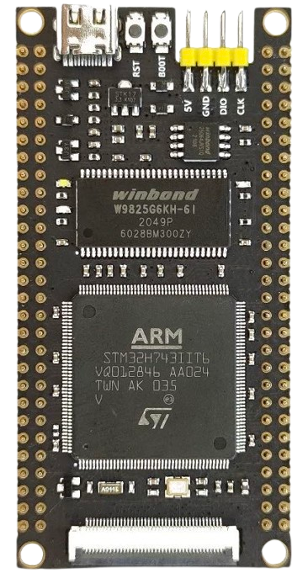
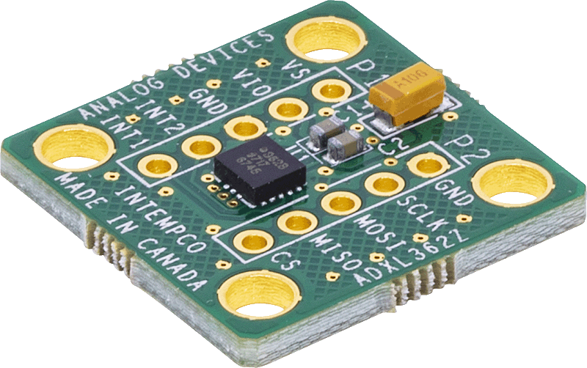
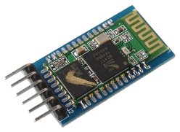
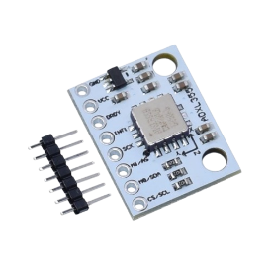
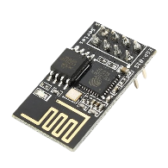
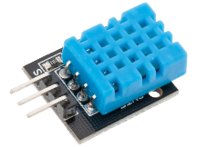
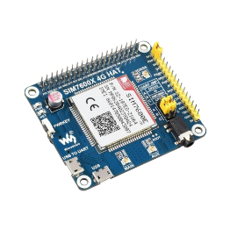
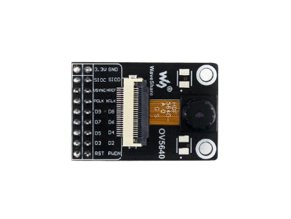
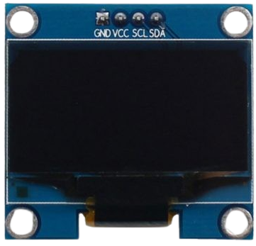
MAIN CONTROL
Microcontroller Unit
STM32H743IIT
480 MHz
TF Card
Up to 32 GB
Random Access Memory
SRAM: 1 MB (built-in)
SDRAM: 32 MB (ext.)
WINBOND W9825G6KH-6I
LED
1 power indication
1 programmable
Button
1 boot; 1 reset
Read Only Memory
FLASH: 2 MB (built-in)
QSPI FLASH: 8 MB (ext.)
WINBOND W25Q64
IO
PIN: 2x2x28, 2.54 mm
Type-C; SWD; Serial
SENSING
COMMUNICATION
Acceleration
Blue Tooth
Low Resolution Accelerometer
12 bit
idle - 270nA/ sensing – 3uA
Near Field Communication
HC-05
ADXL362
HC-05
High Resolution Accelerometer
20 bit
idle – 21uA / sensing – 150uA
WIFI
Internet Connection
ESP8266
IEEE 802.11 B/G/N
ADXL355
ESP-01S
Temperature & Humidity
4G Cellular Network
Environment Sensing
temperature
relative humidity
Internet Connection
SIM-7600
DHT11
SIM-7600
Camera
INTERFACING
Visual Sensing
resolution: 2592x1944
idle – 20uA/ sensing – 140mA
Screen
OLED Display
1.3 inch
OV5640
CH1116
Main Control
Sensing
Communication
Interfacing

Slide 3
Application Specific Code
APPLICATION
LAYER
Edge Intelligence Library for SHM Applications
TinySHM
TinySHM Network
TinySHM AI
TinySHM …
TinySHM Math
TinySHM DSP
TinySHM File
MIDDLEWARE
LAYER
Digital Signal Processing
CMSIS - DSP
Neural Network Computing
CMSIS - NN
File System
FATFS
Real-Time Operating System
FreeRTOS
AI Deployment
X-CUBE-AI
User Customized Drivers
STM32 HAL
DRIVER
LAYER
STM32 HAL (Hardware Abstraction Layer)
Main
Control
Sensing Components
Communication Components
Interfacing Components
PHYSICAL
LAYER

Slide 4
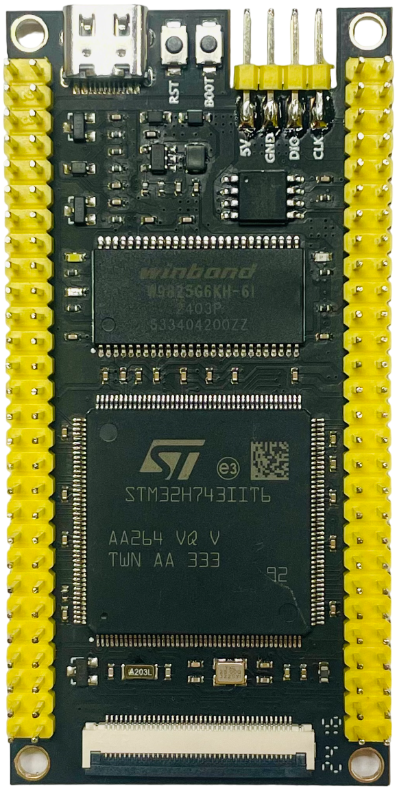

Slide 5
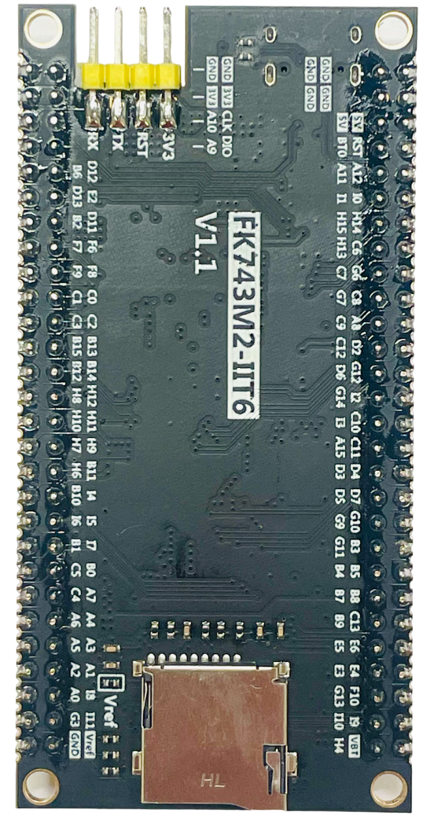

Slide 6
USB-Type C
Buttons – Reset / Boot
LED – Power Status
Debug
LED – BOOT Status
8 MB QSPI FLASH
W25Q64
32 MB SDRAM
W9825G6KH-6I
LED –
Programmable
MCU - STM32H743IIT6
Front View
Serial Communication
PIN
PIN
TF Card Slot
Back View

